Slide 1



YouTube Songs Performance Insights
Made by
Mr. Nilesh Gaddapawar
Data Analyst Intern at Mentorness
Maximum Views

Slide 2
Problem Statement
This internship project aims to conduct a comprehensive analysis of YouTube songs data using Power BI.
The dataset contains key attributes such as video ID, channel title, title, description, tags, published date, view count, like count, favourite count, comment count, video duration, video definition, and caption details.
The goal is to utilize Power BI to create insightful visualizations and reports that provide a deeper understanding of YouTube songs' performance, popularity, and user engagement.
The analysis aims to uncover trends, preferences, and patterns in the data to aid content creators and stakeholders in optimizing their YouTube song content.

Slide 3

Project Objectives
Data Cleaning and Preparation:
Clean and preprocess the dataset, handling missing values or outliers.
Convert relevant columns to appropriate data types.
Exploratory Data Analysis (EDA):
Explore patterns and distributions in view counts, like counts, and comments.
Identify trends in the popularity and engagement of YouTube song videos.
Content and Channel Analysis:
Analyze the distribution of videos across different channels.
Identify popular tags and their correlation with view counts.
Temporal Trends:
Explore how YouTube song video metrics vary over time.
Identify peak publishing times and their impact on engagement.

Slide 4
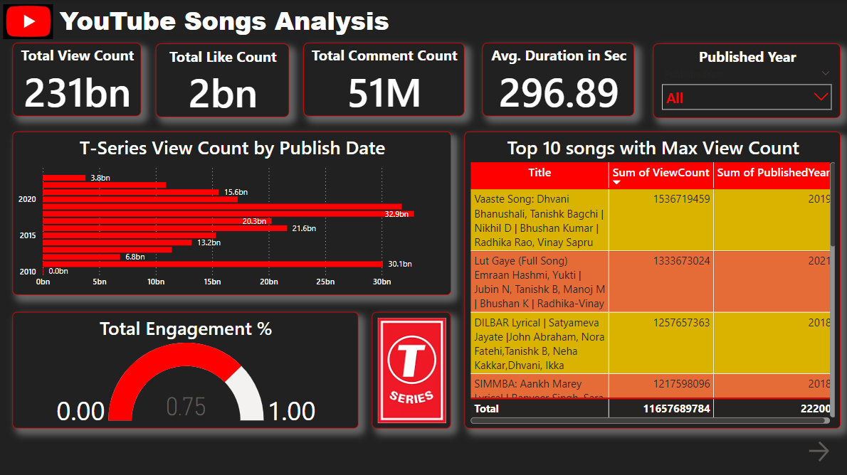

Slide 5
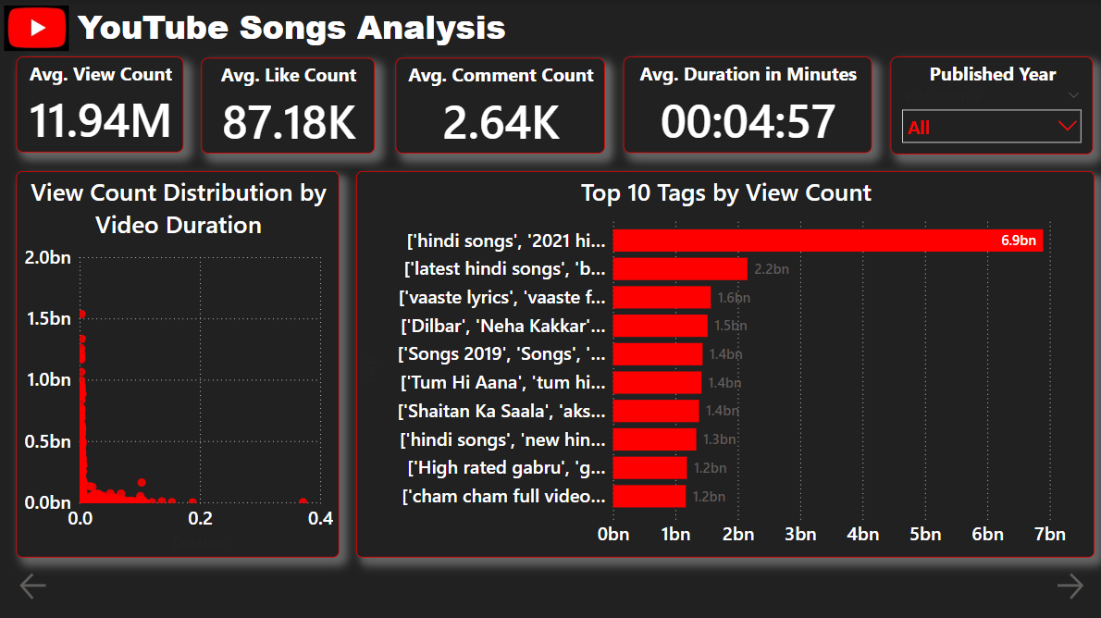

Slide 6
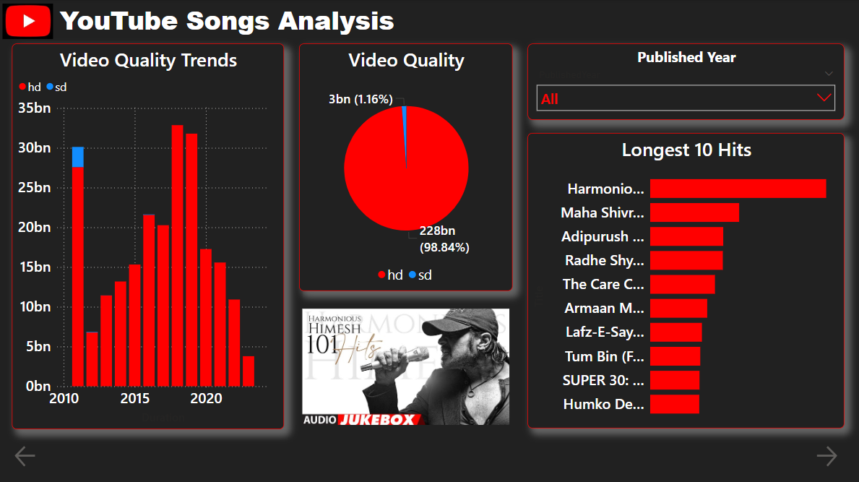

Slide 7
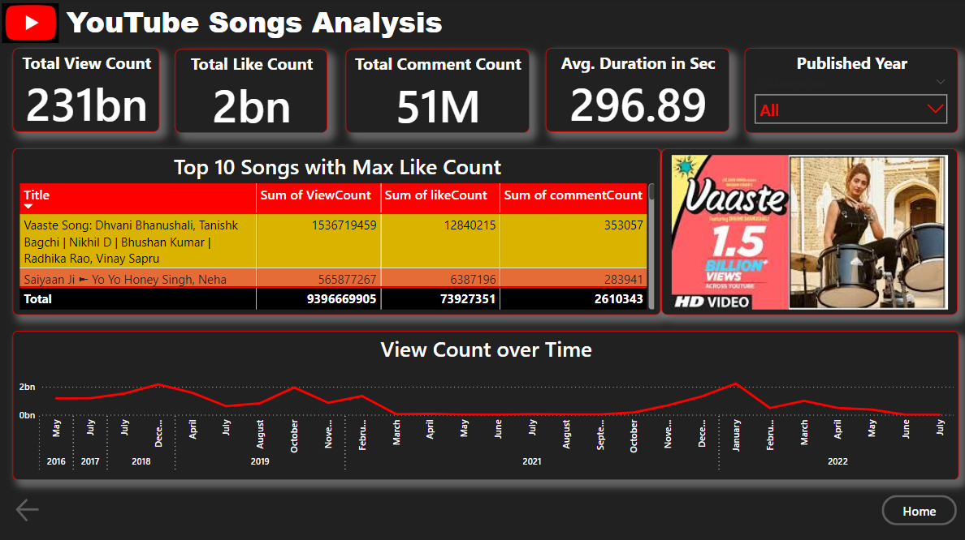

Slide 8

Conclusion
Key Findings:
  Top songs and channels identified
  Views, likes, comments, and engagement analyzed
  Trends in song duration, tags, and captions uncovered
Insights:
  User engagement strategies optimized
  Content strategy informed by data
Next Steps:
  Monitor and analyze YouTube data continuously
  Apply insights to future content creation

Slide 9

Mr. Nilesh Gaddapawar
# Mentorness
# Data Analyst
# Internship

